Slide 1
A Study of Hydration

Slide 2
Question:
Do I drink more water while in a work environment

Slide 3
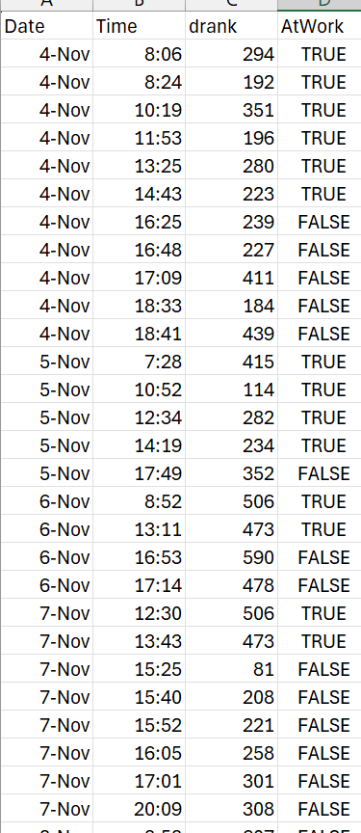
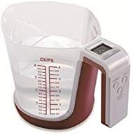
Data
89 Observations gathered over two weeks
The main variable tracked: How much water was drunk
  Using a digital measuring cup
Second main variable tracked: Worked yes or no
An additional variable tracked was time of day
  Would any patterns appear

Slide 4
Hypothesis Testing
Claim: The mean water drunk per hour at work will be more than the mean of the water drunk per hour away from work.
Variables:
  Dependent: Water drunk
  Independent: Worked -> yes or no
Null Hypothesis
  H₀ : µ_{yes} = µ_{no}
Alternative Hypothesis
  H₀ : µ_{yes} > µ_{no}
To test this will be using a t-test

Slide 5
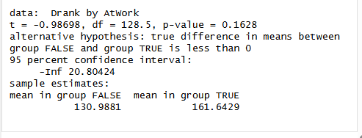
The results
Test Statistic
  T = -.08698
  P-value = 0.1628
Using a significance level of .05 we are unable to reject the null hypothesis.

Slide 6
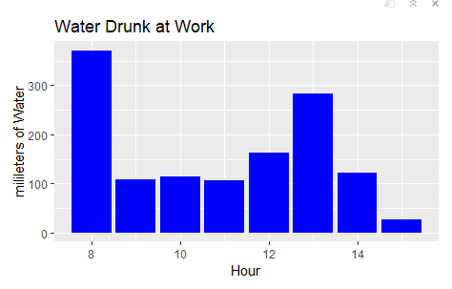
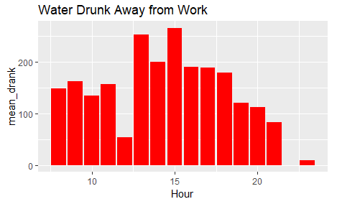
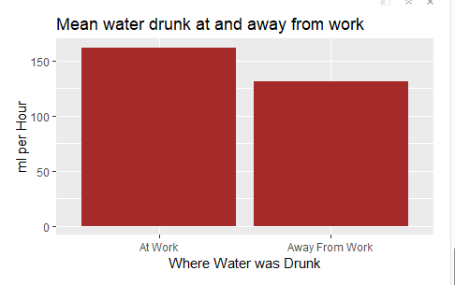
final takeaways
Because we were unable to reject the null hypothesis, we do not have enough evidence to support the claim that I drink more water at work than on days away from work. While results were inconclusive it was interesting to see some of my habits displayed in the graphs shown. Most noticeably on workdays I drink a lot of water when I get to work. Whereas on days off I drink most after I eat lunch.

